Slide 1
AARC 2025
The New Era
Notes:
We are at a pivotal moment of change right now. Emerging from the pandemic, the world will not simply return to pre-pandemic norms, and neither can our association. Now is our opportunity to reimagine our profession, find solutions and create pathways to our future.

Slide 2
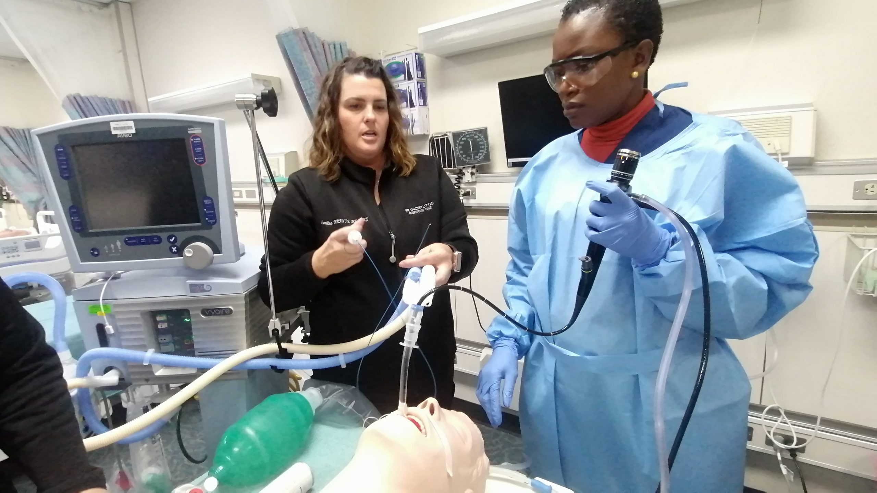
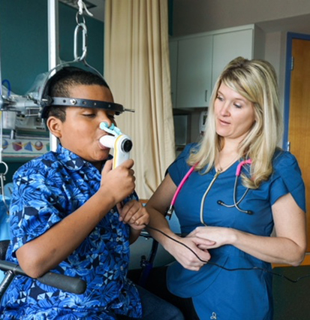
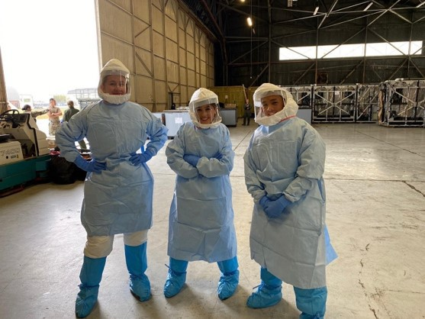



The Foremost Professional Association
for Respiratory Therapists Since 1947
Notes:
In its 75th year, our Association is celebrating a proud history. At the same time, we’re undergoing a dramatic evolution.
We know what the pandemic years have cost us:
Unprecedented stress among Respiratory Therapists – exacerbated by understaffing in our hospitals and too few students entering into our programs
And, the disruption in leadership and culture breakdown in the Exec offices, in the Board, and in the affiliates.
Rest assured, we are not accepting this as the status quo. We fully recognize the current environment and we’re facing the issues head on.
Based on your feedback, work with consultants from within and outside the membership, strategic planning with Board, Affiliate and Association leaders,
We have a strategic vision and we’re acting on our plan to fuel innovation and bring solutions. HERE’s HOW

Slide 3
Objectives
Describe the AARC strategic plan
Share accomplishments against operational goals
Discuss path forward
Disclosures
None

Slide 4
2025 VISION
The AARC will be THE leading organization to advance the profession of respiratory care worldwide.
Notes:
Our Vision is to be indispensable to the RC profession. As the leading RC organization, we will harness the power of our Association and of our credentialing and accreditation partners to lead the profession to new levels of respect and recognition, and a broader scope of advanced practice. Those who wish to serve in a healthcare career will seek out Respiratory Therapy.
AARC will serve our members with the knowledge, leadership and community that will make membership essential to every RT …..
All RTs will want to be an AARC member, and no member will ever want to quit.

Slide 5





The 2025 Strategic Roadmap
The AARC will serve its members and engage, elevate, advocate,
and educate the respiratory care profession.
ENGAGE
ELEVATE
ADVOCATE
EDUCATE
ORGANIZE
We will build and strengthen a diverse and inclusive
professional community.
We will advance the recognition and role of respiratory therapists.
We will champion policies and initiatives that enhance respiratory care.
We will deliver premier, evidence-based learning opportunities and promote the art and science of respiratory care.
We will promote and enable individual and organizational growth.
Notes:
These are the Pathways we will follow to reach our Vision (read and explain each).

Slide 6
AARC Strategic Direction 2022 - 2025
Vision
The AARC will be the leading organization to advance the profession or respiratory care worldwide.
Strategy
The AARC will serve its members and engage, elevate, advocate, and educate the respiratory care profession.
Mission
The AARC is the foremost professional association promoting respiratory therapists.
ENGAGE
We will build and strengthen a diverse and inclusive professional community.
ELEVATE
We will advance the recognition and role of respiratory therapists.
ADVOCATE
We will champion policies and initiatives that enhance respiratory care.
EDUCATE
We will deliver premier, evidence-based learning opportunities and promote the art and science of respiratory care.
ORGANIZE
We will promote and enable individual and organizational growth.
OPERATIONAL GOALS
OPERATIONAL GOALS
OPERATIONAL GOALS
OPERATIONAL GOALS
OPERATIONAL GOALS
1A. Increase membership by 20% and achieve an 85% retention rate.
Q3 2022 - Q4 2025
1B. Increase membership with specific KPIs for students, early professions and AARConnect.
Q3 2022 - Q4 2025
1C. Conduct an organizational Inclusion, Diversity, Equity, Accessibility (IDEA) audit and training.
Q4 2022 - Q4 2023
1D. Engage in rebranding of AARC, including digital presence and collateral.
Q4 2022 - Q4 2023
1E. Create an online portal to promote volunteer opportunities and engagement, including mentorship programs.
Q1 2022 - Q2 2023
1F. Develop and fund an Emerging Leaders Program.
Q2 2023 - Q2 2024
2A. Institute RT PR campaign and achieve 80 media placements.
Q4 2022 - Q4 2023
2B. Create a multi-channel marketing campaign targeting hospital C-Suite to promote value of RTs.
Q4 2022 - Q4 2023
2C. Create task forces to advance credentialing, academic degrees and APRT.
Q4 2022 - Q2 2025
2D. Develop two new allied health organizational relationships that mutually promote the RT profession.
Q1 2023 - Q2 2025
3A. Increase RT’s engagement in advocacy at both federal and state levels by 10%.
Q4 2022 - Q4 2023
3B. Work to pass Allied Healthcare Workforce Diversity Act.
Q3 2022 - Q4 2025
3C. Institute a Compact Licensure Task Force and work plan and goals.
Q4 2022 - Q4 2025
3D. Increase engagement with the Administration, federal agencies and regulatory bodies.
Q1 2023 - Q4 2025
3E. Expand patient access to respiratory therapists outside the acute care setting.
Q3 2022 - Q3 2025
4A. Create at least three new CPGs annually.
Q1 2023 - Q4 2025
4B. Implement and educational resource for respiratory care research methodology and publication, and develop a plan to provide meaningful funding for respiratory therapist investigators.
Q3 2022 - Q3 2023
4C. Increase attendance at AARC meetings by 10%.
Q1 2023 - Q4 2025
4D. Increase education revenue by 10%.
Q1 2023 - Q4 2025
4E. Examine feasibility of publishing an additional journal and determine whether to proceed.
Q1 2023 - Q3 2023
5A. Investigate and recommend an interactive education portfolio CRCE tracker for active communication with members.
Q4 2022 - Q4 2023
5B. Develop three new corporate partnerships.
Q1 2023 - Q4 2025
5C. Review and create ongoing leadership development for Board, Chartered Affiliates, and House Delegates.
Q2 2023 - Q2 2024
5D. Institute and support AARC staff development and training.
Q1 2023 - Q4 2025
Staff and Board Critical Capabilities
Research & Data/Knowledge, Analysis, Influence, Networking, Education, Communication

Slide 7








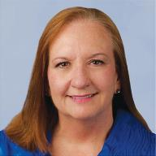
Carl Hinkson
AARC President
Dan Garrett
Executive Director
AARC Board announces Dan Garrett as new Executive Director.
Carl Hinkson inducted as 2023-2024 President of the AARC.
Solidified AARC staff leadership team with 5 positions filled.
New AARC CFO Laverne Davis, effective April 2023.
Successfully elected new 2023 AARC Board Officers and Section Chairs.
Leadership development programs in progress.
Doug Laher
Chief Operating Officer
Monique Talbot
VP, Membership
and Customer Service
Ellen Worsham
VP, Marketing and Communications
Marcus Kerr
VP, Information Technology
Miriam O’Day
SVP, Government Affairs
Mandy DeVries
Director, Education
Lynda Goodfellow
Director, Clinical Practice
Guideline Development

Slide 8
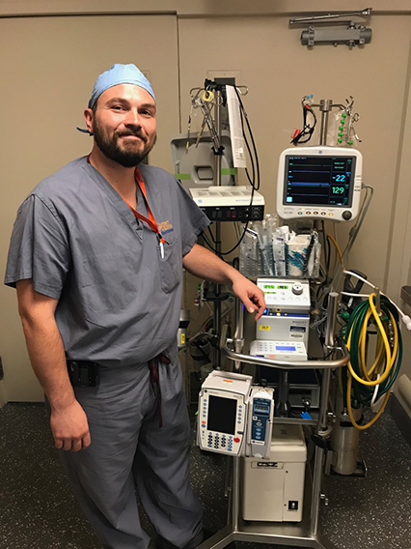
Progress
IDEA / DEI audit, engaged consultants, completed first education session, member survey upcoming.
Membership committee revamped.
Evaluating pre-professional.
Upgraded AARConnect online community, adding volunteer portal and mentoring module in 2023.
Developing Emerging Leaders Program.

Slide 9
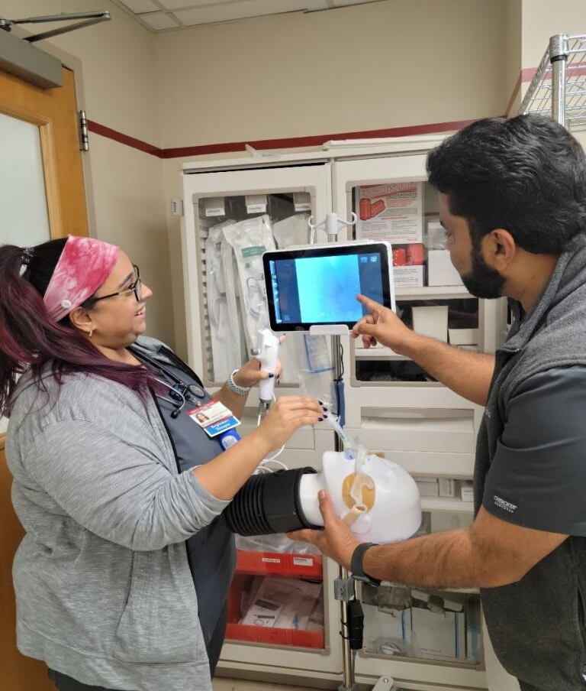
Progress
Rebranding, to optimize member value, AARC Congress rollout.
Improving digital performance.
15 industry leaders sign on as AARC Corporate Partners.
Launched new Career Center, enhanced solutions for job seekers and recruitment.
Student and lapsed-member recruitment campaigns.

Slide 10
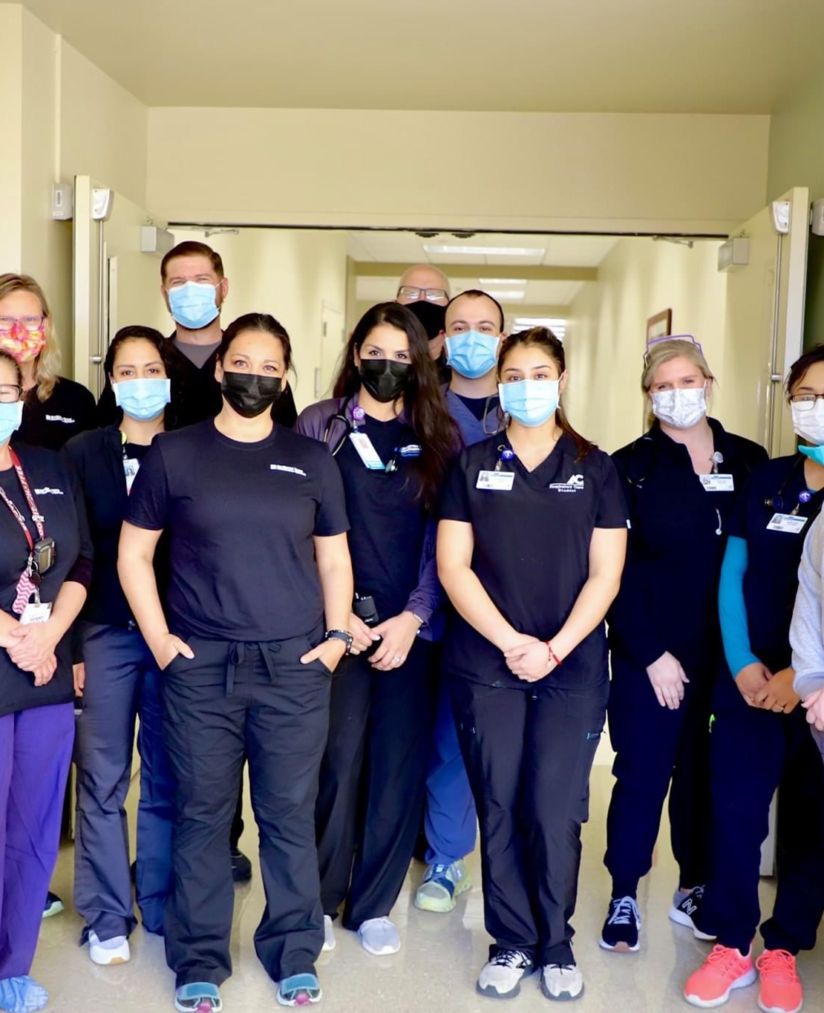
Headline
AARC celebrated its 75th Anniversary with special events throughout the year, including an anniversary museum at Congress.
The Respiratory Care Collaborative / More RTs campaign kicked off - a partnership between the AARC, NBRC, and CoARC to engage health care leadership, garner greater recognition and recruit to the RT profession
AARC published 12 podcasts, 14 videos and multiple webinars in a series to share knowledge resources, advocacy and trending topics relevant to RTs

Slide 11


Awarded
Inducted 20 AARC Members as Fellows of the AARC
Six industry leaders received AARC Zenith Award
Douglas S. Gardenhire named 2022 Jimmy A. Young Medalist
8 AARC Members Named 2022 Specialty Practitioner of the Year
20 AARC members named Recognized Clinical Preceptors

Slide 12















Our Priorities
PR Campaign: Engaged with 5W PR to amplify recognition for AARC and the RT’s role within healthcare among key top-tier media, reaching key stakeholders, potential students, patients, and partners.
>50 media placements since June 2022, many in top-tier outlets

Slide 13

Headline
Advanced Practice Respiratory Therapist (APRT) Taskforce. Working to bring this new role to reality: schools, credentialing, and reimbursement.
Workforce Recovery Taskforce. Helping schools market their program & fill seats. Partnering with HOSA in 2023.
Vision Grant. Dedicated research fund for projects that demonstration value of RTs.

Slide 14

Headline
Educational Journey & Role Advancement. Group dedicated for highlighting RT roles in the traditional bedside setting.
  2023-2024 APEX designation. Awarded to 29 hospital and accredited college programs that demonstrate high quality respiratory care and educational practices.
  Special representatives to other organizations. AARC has a special rep to nearly 20 other health-care organizations.

Slide 15

Successes
PASSED! U.S. Congress passes $1.7 trillion omnibus which included the Allied Healthcare Workforce Diversity Act.
AARC takes a stand on workplace violence, supports the Safety from Violence for Healthcare Employees (SAVE) Act of 2022 introduced on June 7, 2022.
AARC supports petition to help Remove Non-Clinical Oxygen Concentrators from Online Purchase.

Slide 16
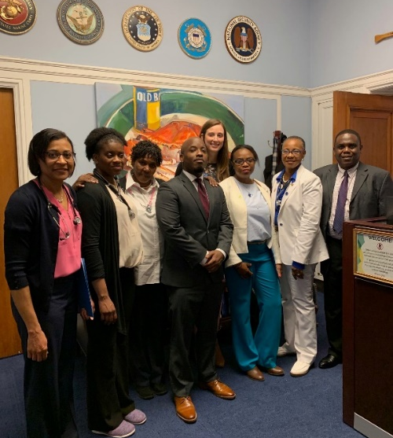
Successes
AARC works to Reform Access to Supplemental Oxygen.
AARC takes part in Feb 2023 CMS meeting.
AARC joins others to bring New Pulmonary Rehabilitation Reimbursement Toolkit and PR Coding and Billing webinar training to RTs.
AARC takes action to afford Veteran access to respiratory therapists in RT- staffed VA hospitals.

Slide 17
Headline
Compact Licensure Taskforce created to explore opportunities to bring compact licensure to respiratory therapy.
AARC advocates for the Expansion of Virtual Pulmonary Rehab Services, including Telehealth Coverage to give recognition to Respiratory Therapist’s vital role as disease managers.
Implemented new software platform for action and engaged in efforts regarding state licensure and scope of practice in @ 1/3 of the U.S.
PACT “day” in September – join the effort!

Slide 18
2022 AARC Congress returns - more than 3,500 attendees, offering 20.66 CRCE, 154 exhibitors, and 116 presentations.
AARC Summer Forum for leadership and management is in-person for the first time in two years, a record number of exhibitors participate.
Published 2022 Edition of the Respiratory Care Education Annual.
Executing on resources to support respiratory care research, including a Master Class held at Congress 2022.
CPG Team creates 3 new Clinial Practice Guidelines in 2022, evaluating a Pediatric Critical Asthma topic for development.
New “COVID-19: Lessons Learned” course and guidebook produced.
Respiratory Care Journal, the official science journal of the AARC, published monthly, listed in Index Medicus and included in Web of Science, goes all-digital.
CRCE Tracker in early development.

Slide 19
AARC Strategic Direction 2022 - 2025
Vision
The AARC will be the leading organization to advance the profession or respiratory care worldwide.
Strategy
The AARC will serve its members and engage, elevate, advocate, and educate the respiratory care profession.
Mission
The AARC is the foremost professional association promoting respiratory therapists.
ENGAGE
We will build and strengthen a diverse and inclusive professional community.
ELEVATE
We will advance the recognition and role of respiratory therapists.
ADVOCATE
We will champion policies and initiatives that enhance respiratory care.
EDUCATE
We will deliver premier, evidence-based learning opportunities and promote the art and science of respiratory care.
ORGANIZE
We will promote and enable individual and organizational growth.
OPERATIONAL GOALS
OPERATIONAL GOALS
OPERATIONAL GOALS
OPERATIONAL GOALS
OPERATIONAL GOALS
1A. Increase membership by 20% and achieve an 85% retention rate.
Q3 2022 - Q4 2025
1B. Increase membership with specific KPIs for students, early professions and AARConnect.
Q3 2022 - Q4 2025
1C. Conduct an organizational Inclusion, Diversity, Equity, Accessibility (IDEA) audit and training.
Q4 2022 - Q4 2023
1D. Engage in rebranding of AARC, including digital presence and collateral.
Q4 2022 - Q4 2023
1E. Create an online portal to promote volunteer opportunities and engagement, including mentorship programs.
Q1 2022 - Q2 2023
1F. Develop and fund an Emerging Leaders Program.
Q2 2023 - Q2 2024
2A. Institute RT PR campaign and achieve 80 media placements.
Q4 2022 - Q4 2023
2B. Create a multi-channel marketing campaign targeting hospital C-Suite to promote value of RTs.
Q4 2022 - Q4 2023
2C. Create task forces to advance credentialing, academic degrees and APRT.
Q4 2022 - Q2 2025
2D. Develop two new allied health organizational relationships that mutually promote the RT profession.
Q1 2023 - Q2 2025
3A. Increase RT’s engagement in advocacy at both federal and state levels by 10%.
Q4 2022 - Q4 2023
3B. Work to pass Allied Healthcare Workforce Diversity Act.
Q3 2022 - Q4 2025
3C. Institute a Compact Licensure Task Force and work plan and goals.
Q4 2022 - Q4 2025
3D. Increase engagement with the Administration, federal agencies and regulatory bodies.
Q1 2023 - Q4 2025
3E. Expand patient access to respiratory therapists outside the acute care setting.
Q3 2022 - Q3 2025
4A. Create at least three new CPGs annually.
Q1 2023 - Q4 2025
4B. Implement and educational resource for respiratory care research methodology and publication, and develop a plan to provide meaningful funding for respiratory therapist investigators.
Q3 2022 - Q3 2023
4C. Increase attendance at AARC meetings by 10%.
Q1 2023 - Q4 2025
4D. Increase education revenue by 10%.
Q1 2023 - Q4 2025
4E. Examine feasibility of publishing an additional journal and determine whether to proceed.
Q1 2023 - Q3 2023
5A. Investigate and recommend an interactive education portfolio CRCE tracker for active communication with members.
Q4 2022 - Q4 2023
5B. Develop three new corporate partnerships.
Q1 2023 - Q4 2025
5C. Review and create ongoing leadership development for Board, Chartered Affiliates, and House Delegates.
Q2 2023 - Q2 2024
5D. Institute and support AARC staff development and training.
Q1 2023 - Q4 2025
Staff and Board Critical Capabilities
Research & Data/Knowledge, Analysis, Influence, Networking, Education, Communication
Notes:
Summarize activies

Slide 20
Thank You

